Slide 1
BLUETOOTH WHEEL CHAIR

Slide 2
ABSTRACT
We are now living in the 21st century. Now, smart phone has become the most essential thing in our daily life. Android application based smart phones are becoming each time more powerful and equipped with several accessories that are useful for Robots. This project describes how to control a robot using mobile through Bluetooth communication, some features about Bluetooth technology, components of the mobile and robot. We present a review of robots controlled by mobile phone via moving the robot upward, backward, left and right side by the android application such as Arduino, Bluetooth. Bluetooth has changed how people use digital device at home or office, and has transferred traditional wired digital devices into wireless devices. Here we are using Bluetooth communication, interface microcontroller and android application. We are using Arduino software to interface the Bluetooth module with microcontroller. According to commands received from android the robot motion can be controlled. We derived simple solutions to provide a framework for building robots with very low cost but with high computation and sensing capabilities provided by the smart phone that is used as a control device.

Slide 3
INTRODUCTION
This paper represents android application based Bluetooth controlled robotic car. Here main motto of our project is to control the car with android application. Here we use mainly Arduino UNO (ATMEGA 328P), Bluetooth module (HC-05). We interface the Bluetooth module with the system so that we can easily control the system by smart phone application. This project is more necessary to the modern society in context of spying and surveillance. The project aims in designing a Robot that can be operated using Android mobile phone. The controlling of the Robot is done wirelessly through Android smart phone using the Bluetooth feature present in it. Here in the project the Android smart phone is used as a remote control for operating the Robot. The controlling device of the whole system is a Microcontroller. Bluetooth module, DC motors are interfaced to the Microcontroller. The data received by the Bluetooth module from Android smart phone is fed as input to the controller. The controller acts accordingly on the DC motors of the Robot. In achieving the task the controller is loaded with a program written using Embedded ‘C’ language. Related reference articles implementing wireless control of robots have been studied as mentioned in [1-12]. Still there exists a requirement of a cost-effective automation system, which will be easy to implement. An example of such a cost-effective project has been proposed here.

Slide 4
The system consists of following parts:
Arduino UNO (ATMEGA 328P
Bluetooth module (HC-05)
Smart phone
Motor driver (l293D)
Arduino software (version 1.8.1)

Slide 5
Arduino Software (Version 1.8.1)
Arduino software (Figure 5) is used to put the instruction of whole functions of this system to the microcontroller. Here we use programming language ‘C’ for coding. The program for executing this project has been written in C language. The program is burnt in the microcontroller using burner software. The program is stored in the EEPROM of themicrocontroller, which is present in the Arduino board. By this software we put the data and instruction for forward, backward, left, right operation of this system.

Slide 6
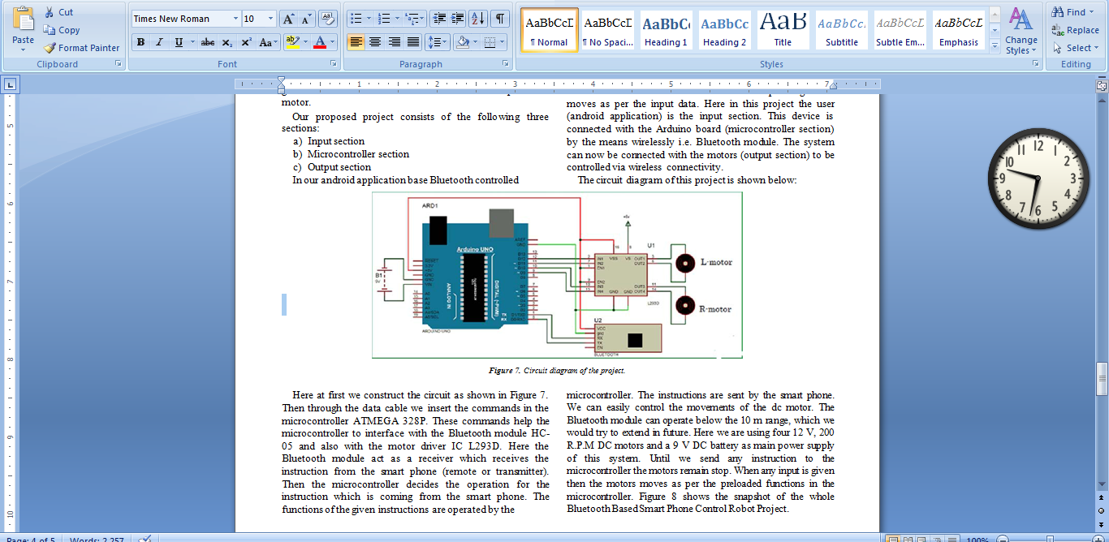
CIRCUIT DIAGRAM

Slide 7
The circuit diagram of this project is shown below microcontroller. The instructions are sent by the smart phone. We can easily control the movements of the dc motor. The Bluetooth module can operate below the 10 m range, which we would try to extend in future. Here we are using four 12 V, 200 R.P.M DC motors and a 9 V DC battery as main power supply of this system. Until we send any instruction to the microcontroller the motors remain stop. When any input is given then the motors moves as per the preloaded functions in the microcontroller. Figure 8 shows the snapshot of the whole Bluetooth Based Smart Phone Control Wheel Chair Project

Slide 8
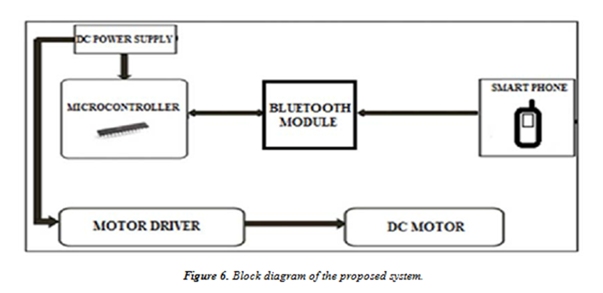

Slide 9
COMPLETE PROJECT

